Slide 1
System Models
Chapter -2

Slide 2
SYSTEM MODELS
Architectural Model
-> It is concerned with the placement of its parts and relationship between them.
-> How they interact with one another and how they mapped in the network
Eg. Client – Server and Peer – Peer Model
C-S (Replication, Caching, use of mobile code and mobile agents and requirement to add and remove mobile devices)
Fundamental Model
-> these are concerned with design issues, difficulties and threats and how to resolve that to fulfil their tasks correctly, reliably and securely.

Slide 3
Fundamental model…
Since there is no global time in DS , all communication b/w processes is achieved by means of messages.
Message communication over a computer network can be affected by following issues.
They are
->Delays
->Variety of failures
->Vulnerable to security attacks

Slide 4
These above issues are addressed by 3 models
Interaction Model – Deals with performance and with the difficulty of setting time limits in a DS. Eg. Message Delivery
Failure Model – It gives a precise specification of faults that can be exhibited by processes and communication channels. It defines reliable communication and correct processes.
Security Model – It discusses the possible threats to processes and communication channels. Use secure channels to fight against these threats.

Slide 5
ARCHITECTURAL MODELS
It defines the way in which the components of systems interact with one another and the way they are mapped onto an underlying n/w of computers.
Major concern is to make
system reliable
manageable
adaptable
cost effective

Slide 6
AM considers
Placements of components across a n/w of computers
Interrelationship b/w the components.
Initial simplifications are achieved by classifying processes as → Server Processes
→ Client Processes
→Peer Processes.
This classification identifies the responsibilities of each and helps us to asses their workloads and to determine the impact of failures
How to make this C-S model dynamic?
Eg. Codes can be downloaded from server and execute on client side (access delays and communication traffic can be reduced)
Eg. Mobile code and Discovery of services in mobile n/ws

Slide 7
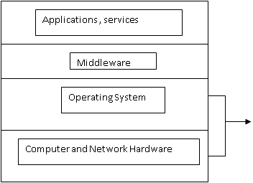
Software Layers
Platform

Slide 8
Platform: Lowest level h/w and s/w layers are often reffered to as a platform for DS. This low level layers provide services to the layers above them , that is implemented in each computer.
Middleware: It is a layer of s/w that masks heterogeneity and to provide a convenient programming model to application programmers.

Slide 9
Examples of Middleware
Database access technology, RDA - e.g ODBC (Open DataBase Connectors)
Java’s database connectivity API : JDBC
Remote computation products - e.g RPC and RMI (Java Remote Method Invocation)
Distributed Computing Environment (DCE) products, Common Object Request Broker Architecture (CORBA), Distributed Component Object Model (DCOM)
CORBA – services includes naming service, security, transactions, persistent storage and event notification etc…
What is Web service middleware? How it differs from other middleware?

Slide 10
System Architectures (Client – Server)
The division of responsibilities b/w system components and placement of components on computers in the n/w is an important aspect in DS
Two types of AM → C-S and P-P
client process interact with individual server process in separate host computers in order to access the shared resources that they manage.
Sometimes server becomes the client of another server
Web server sometimes becomes the client of Local file server
Webserver and most internet services are the client of
DNS services- translates Internet Domain Names to n/w address
Search Engines - acts as server by responding queries to
browser clients .
Crawler – makes request to other web servers…and acts as client

Slide 11
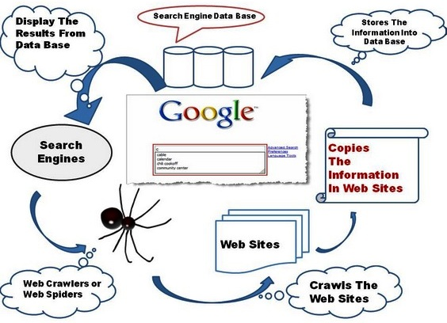
Web Crawler
Web crawlers help in collecting information about a website and links related to them and also helps in validating HTML code and
hyperlinks

Slide 12
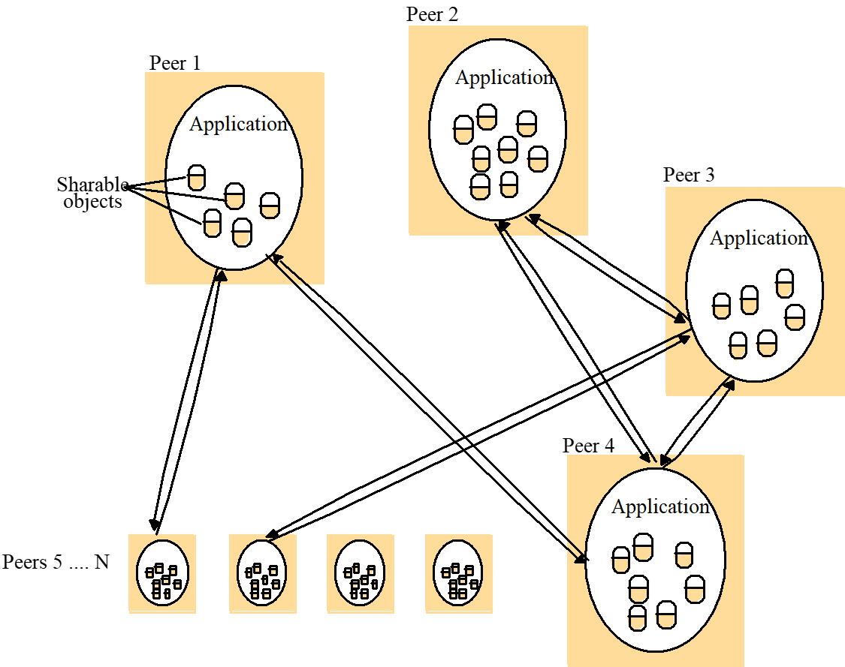
Peer-to-peer Systems
All plays similar roles here
Centralization of service and management do not scale well beyond the capacity of the system.
P-P aim is to exploit h/w and s/w resources maximum from all participating computers
Resources and objects have to be replicated and distributed in all systems to provide resilience and smooth uninterrupted communication.
Bcos of these issues, P-P architecture became so complex than C-S architecture.

Slide 13
Variations in existing model to provide
To increase performance and resilience ( multiple servers and caches)
Use of mobile code and mobile agents
Low cost computer with limited h/w resources (better management)
Adding and removing mobile devices in a convenient manner
Services Provided by Multiple Servers:
• Replication is used to increase performance and availability and to improve fault tolerance.
How clustering Web services would greatly boost the ability of
Web service search engine to retrieve relevant services?

Slide 14
Proxy Servers and Caches
• When an object is needed by a client process the caching service first checks the cache and supplies object from there if an up- to-date copy is available. If not up-to-date , then data is fetched from the resource maintained.
• The purpose of proxy server is to increase availability and performance of the service by reducing load on the wide area n/w and web servers.

Slide 15
Mobile Code:
Eg. of mobile code is applet. User running a browser selects a link to an applet whose code is stored on a web server. The code is downloaded to the browser and runs there.
This will not suffer from delay and other BW related issues associated with n/w communication

Slide 16
How user should be kept up to date like server….
Push Model: Server instead of client initiates interaction. Clients should kept up-to-date with changes (when client initiates, this is not possible) so push model introduced. (To keep cached data up to date by downloading s/ws that update data from servers )
Eg. stock market price changes should be notified…
Mobile Agents: carries(both code and data) travels from one comp to another in a network eg. collecting information and returning with result etc..
Advantage is… reduction in communication cost and remote invocations can be avoided but….
Faces potential security threats to the resources in computers they visit.
Before it access local resources – based on the identity of the user (on whose behalf agent is acting) – their identity must be included in a secure way with the code and data of the mobile agent.

Slide 17
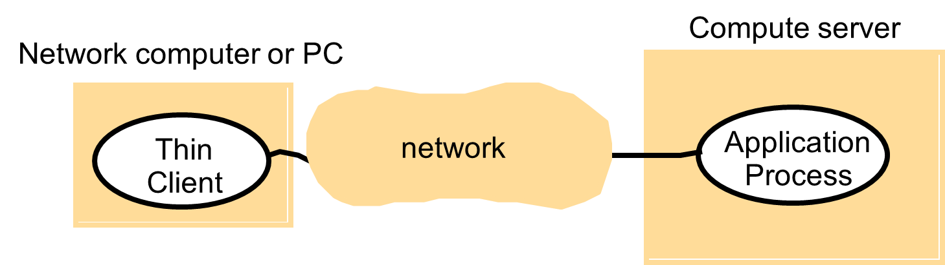
Network computers:
- downloads the OS and any application software needed by the user from a remote file server. - applications are run locally but the files are managed by a remote file server. - the users may migrate from one network computer to another.
Thin Client:

Slide 18
Thin client:
- a software layer that supports a window-based user interface on a computer that is local to the user and executes application programs on a remote computer. - has the same low management and hardware costs as the network computer scheme - instead of downloading the code of applications into the user's computer, it runs them on a compute server (should be a powerful server to run large no. of applications simultaneously)
Main drawback is in highly interactive graphical activities like image processing – delay would be increased and also results in n/w and OS latencies (time required to transfer image or any data)

Slide 19
Mobile Devices and Spontaneous Networking:
The form of distribution that integrates mobile devices and other devices into a given network is spontaneous networking. It involves the connection of mobile and non – mobile devices to network.
Eg. Mobile Phones, Digital Camera , Smart Watches etc…
By using GPS, we can make server itself mobile….
Connectivity is an issue…results in association of devices are routinely connected and destroyed….

Slide 20
Key features of Spontaneous Networking:
Easy connection to local network: Wireless links avoid the need for pre installed cabling and avoid the inconvenience and reliability issues surrounding plugs and sockets. Only communication on the move.
Easy Integration with local services: Devices that find themselves inserted into existing networks of devices discover automatically , what services are provided there with no special configuration.

Slide 21
Design Requirements:
Depends on → Performance Issues
Depends on → Quality of Services
Depends on → Caching and Replication - web caching protocol
Depends on → Dependability Issues
Responsiveness
Throughput
Balancing Computational Loads
Reliability
Adaptability
Resource Availability
Security
Performance
Correcteness
Security
Fault Tolerance

Slide 22
Performance Issues:
Responsiveness: Not only depend on load, server performance and n/w but also delay in s/w layers.
Throughput : Rate at which computational work is done which depends on processing speed. It is affected at client, server and data transfer rates)
Balancing computational loads:
* Proceed concurrently without competing for resources
* Ability to run code on client side removes load on server
* Use DNS to return the host address from a single domain name.

Slide 23
FUNDAMENTAL MODEL:
Interaction
Failure
Security
→ Interaction:
Computation occurs within processes. The processes interact by passing msg’s resulting in communication and coordination b/w processes.

Slide 24
→ Failure:
This model defines and classifies the faults. This provides a basis for analysis of their potential effects and for the design of systems that are able to tolerate faults of each type while continuing to run correctly.
→Security:
Nature of DS and their openness exposes them to attack by both external and internal agents. This model defines and classifies that , and such attacks may take , providing a basis for the analysis of threats to a system and for the design of systems that are able to resist them.

Slide 25
Interaction Model:
Multiple server processes may cooperate with one another to provide a service.Eg. Domain name service which partition and replicates its data at servers throughout the internet.
Two significant factors affecting interacting processes in DS:
Communication performance
Impossible to maintain a single global notion of time.

Slide 26
Performance of Communication channel:
Communication over computer n/w has following performance characteristic relating to
a) Latency b) Bandwidth c) Jitter
Latency: The delay b/w start of msg transmission from one process and the beginning of its receipt by another.
Time taken for a string of bits transmitted thru the n/w to reach its destination
Delay in accessing the n/w
Time taken by the OS communication services at both sending and receiving processes.

Slide 27
Bandwidth: It is the total amount of information that can be transmitted over it in a given time.
Jitter: Variation in time taken to deliver a series of messages.

Slide 28
Two Variants of Interaction Model:
Synchronous DS
Asynchronous DS

Slide 29
Synchronous DS:
The time taken to execute each step of a process has known lower and upper bound.
Each msg transmitted over a channel is received within a known bounded time.
Each process has a local clock whose drift rate from real time has a known bound.

Slide 30
Asynchronous DS:
System with no bounds.
Each step may take arbitrarily long time.
Msg may be received after an arbitrarily long time.
Drift rate of the clock is arbitrary
In this there will be no assumptions about the time interval involved in any execution.

Slide 31
Interaction model
Eventordering - In many cases, we are interested in knowing whether an event at one process occurred before, after or concurrently with another event at another process. - The execution of a system can be described in terms of events and their ordering despite the lack of accurate clocks.

Slide 32
Interaction model
Event ordering example-
Following is a set of exchanges between a group of email users X, Y, Z and A on a mailing list:
user X sends a message with the subject Meeting;
users Y and Z reply by sending a message with the subject Re: Meeting.

Slide 33
Figure 2.8 Real-time ordering of events

Slide 34
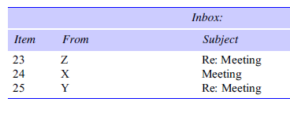
Interaction model
user A might see:

Slide 35
Interaction model
If the clocks on X’s, Y’s and Z’s computers could be synchronized, then each message could carry the time on the local computer’s clock when it was sent.

Slide 36
Interaction model
Clocks cannot be synchronized perfectly across a distributed system.
Lamport proposed a model of logical time that can be used to provide an ordering among the events at processes running in different computers.

Slide 37
Failure Model:
Both processes and communication channels may fail.
These are presented as
Omission Failure
Arbitrary Failure
Timing failure
Masking Failure
Reliability of 1-1 communcation

Slide 38
Omission Failure
Process Omission Failure
Communication Omission Failure
→Send Omission Failure
→Receive Omission Failure
→Channel Omission Failure

Slide 39
Process Omission Failure:
-> Omission failure of a process is crash. A process is crashed means it has halted and will not execute further steps.
-> Crash detection relies on the use of timeouts ie. one process allows fixed period of time for something to occur.
->A process crash is called fail-stop , if other process can detect that the process has crashed.

Slide 40
Communication Ommission Failure

Slide 41
Arbitrary Failures:
It describes worst possible failure semantics, in which any type of error occurs.
Msg content may be corrupted or non existent msg’s may be delivered or real msg’s may be delivered more than once etc

Slide 42
Timing Failure:
Applicable in synchronous DS where time limits are set on process execution time, msg delivery time and clock drift rate.

Slide 43
Masking Failures:
Each component in DS is constructed from a collection of other components.
Service masks a failure either by hiding it altogether or by converting it into a more acceptable type of failure.
Eg. Multiple servers hold replicas of data can continue to provide a service when one of them crashes.

Slide 44
Reliability of one to one communication:
Reliable communication is defined in terms of validity and integrity.
Validity: Any msg in the outgoing msg buffer is eventually delivered to the incoming msg buffer.
Integrity: The msg received is identical to one sent and no msgs are delivered twice.
Threats to integrity come from two independent sources:
Any protocol that retransmit msgs but not reject a msg that arrives twice. Protocols can attach sequence number to msgs to detect that are delivered.
Malicious users inject spurious msgs, replay old msgs, or tamper with msgs. Security measures can be taken to maintain the integrity property in such cases.

Slide 45
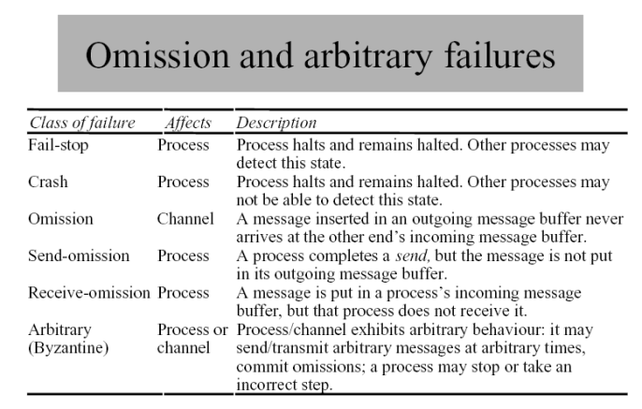

Slide 46
Security:
Security of distributed system can be achieved by securing the processes and the channels used for their interactions and by protecting the objects that they encapsulate against unauthorized access.

Slide 47
Access rights specify who is allowed to perform operations of an object. The server is responsible for checking the identity of the principal behind each invocation and checking that they have sufficient access rights to perform requested operation on object invoked.

Slide 48
Security model
Security can be achieved by - securing the processes and the channels used for their interactions - protecting the objects that they encapsulate against unauthorized access.

Slide 49
Security model
Protecting objects
Consider a server that manages a collection of objects on behalf of some users.
Objects are intended to be used in different ways by different users. - Access rights specify who is allowed to perform the operations of an object - Principal is the authority which is associated with each invocation and each result

Slide 50
Security model
The enemy
To model security threats, we postulate an enemy …
The threats from a potential enemy include - threats to processes - threats to communication channels - denial of service

Slide 51
Security model
The enemy
Threats to processes: - a process may receive a message from any other process in the distributed system - Servers - Clients
Threats to communication channels: An enemy can copy, alter or inject messages as they travel across the network and its intervening gateways. Attempt to save copies of messages and to replay them at a later time.

Slide 52
Figure 2.14 Secure channels
A
Principal
B
Principal
p
Process
Secure channel
Process
q

Slide 53
Models for the analysis of security threats:
Enemy

Slide 54
The threats from a potential enemy discussed as
threats to processes
threats to communication channel
denial of service

Slide 55
Defeating security threats:
Cryptography and shared secrets
Authentication
Secure channels

Slide 56
Uses of security models:
control of access to objects using access rights
use of secure channel for communication
Encryption and decryption techniques

